Slide 1
HR Analytics: Employee Retention

Slide 2
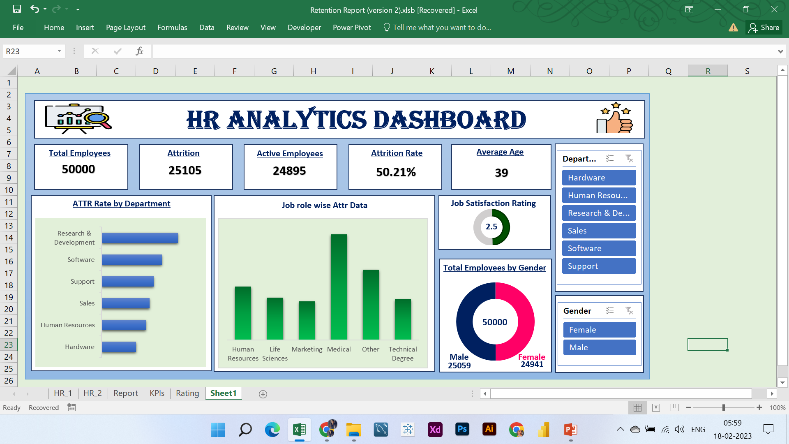
EXCEL

Slide 3
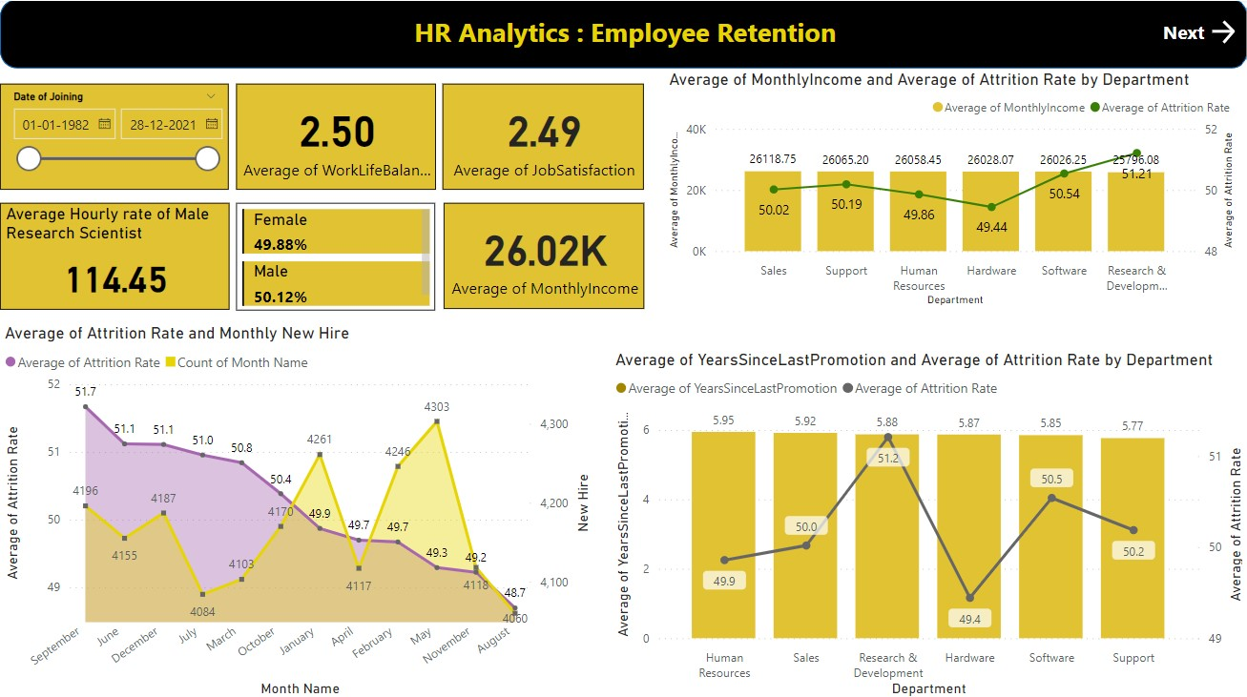
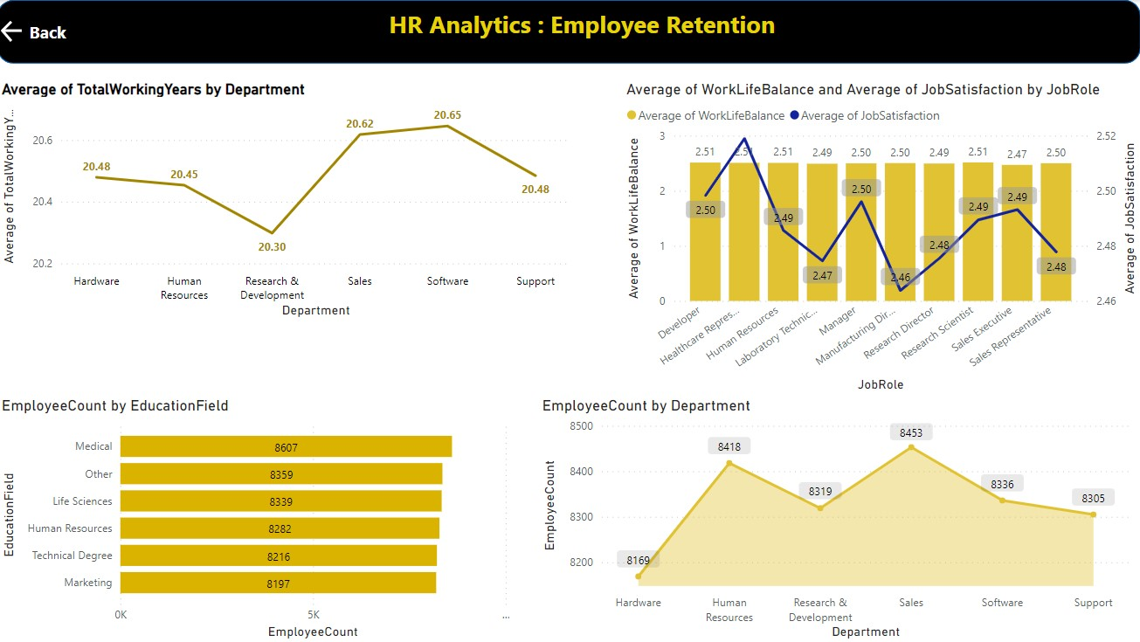
Power BI Dashboard

Slide 4
Power BI (data model and DAX)
Date of Joining = DATE(Sheet1[Year of Joining],Sheet1[Month of Joining],Sheet1[Day of Joining])
Year = YEAR(Sheet1[Date of Joining].[Date])
Month Number = MONTH(Sheet1[Date of Joining])
Month Full Name = FORMAT(Sheet1[Date of Joining],"MMMM")
Quarter = FORMAT(Sheet1[Date of Joining],"Q")
Year Month = FORMAT(Sheet1[Date of Joining],"YYYY-MMM")
Weekday Number = WEEKDAY(Sheet1[Date of Joining],1)
Weekday Name = FORMAT(Sheet1[Date of Joining],"DDDD")
Financial Month = IF(Sheet1[Month No.]<7,Sheet1[Month No.]+6,MOD(Sheet1[Month No.],7)+1)
Financial Quarter = IF(Sheet1[Month No.]>=1&&Sheet1[Month No.]<4,"FQ3",IF(Sheet1[Month No.]>=4&&Sheet1[Month No.]<7,"FQ4",IF(Sheet1[Month No.]>=7&&Sheet1[Month No.]<10,"FQ1","FQ2")))

Slide 5

Tableau daSHBOARd

Slide 6
Tableau (data model and Calculated fields)
Date of Joining = MAKEDATE([Year of Joining],[Month of Joining],[Day of Joining])
Year = YEAR([Date of Joining])
Month Number = MONTH([Date of Joining])
Month Full Name = DATENAME('month',[Date of Joining])
Quarter = QUARTER([Date of Joining])
Year Month = FORMAT(Sheet1[Date of Joining],"YYYY-MMM")
Weekday Number = ISOWEEKDAY([Date of Joining])

